Slide 1
Algorithm Efficiency Across Various Platforms
Connor Ramsden, Miller Roman

Slide 2

Why this project?

Slide 3





Our Platforms:
CPU - Visual Studio without Mutex
Compute Shaders OpenGL/GPU - Unity
CPU with threads - Visual Studio with Mutex
CUDA/GPGPU - Visual Studio

Slide 4

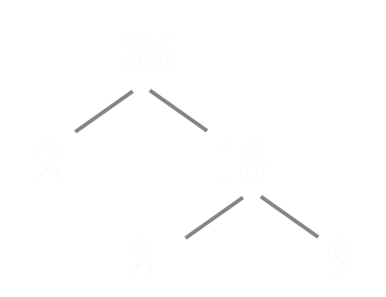
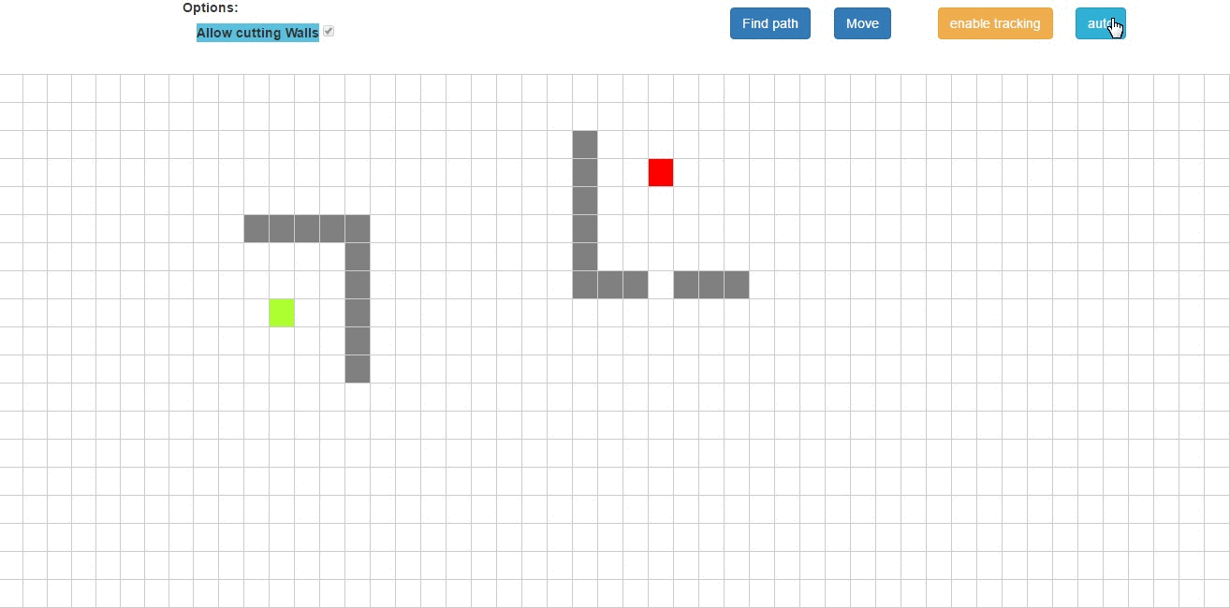
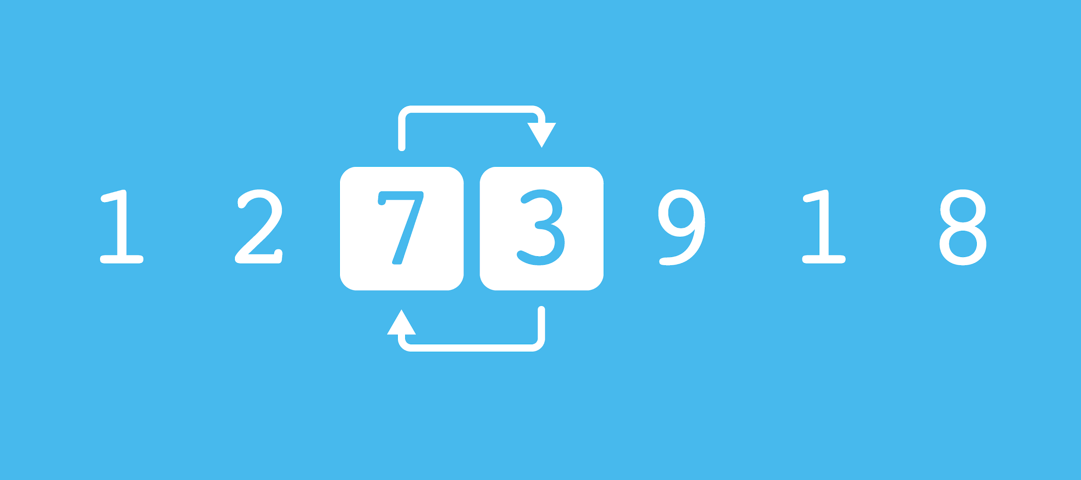
Our Starting Point
Conway’s Game of Life
Prime Factorization
Sorting Algorithm(s)
A-Star pathfinding

Slide 5


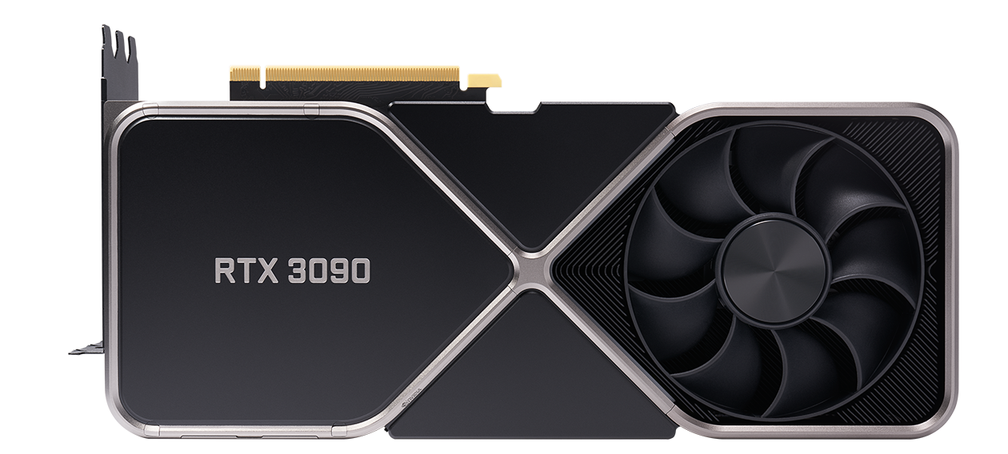
Software/Hardware Needs
Yes, we need THIS one. School should buy it for us!

Slide 6


Questions?

